Slide 1
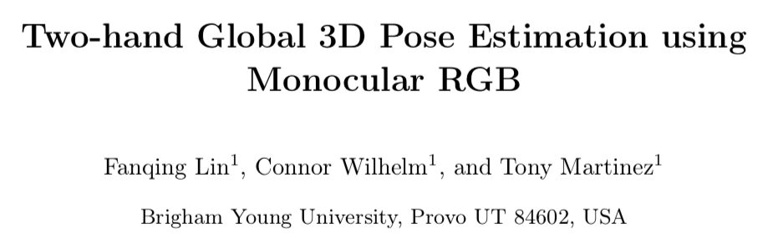

Slide 2
Contribution
RGB
=> 2D, 3D canonical joint locations
=>
Global to camera origin
Key bone length using projection algorithm
Synthetic 3D hand pose dataset

Slide 3
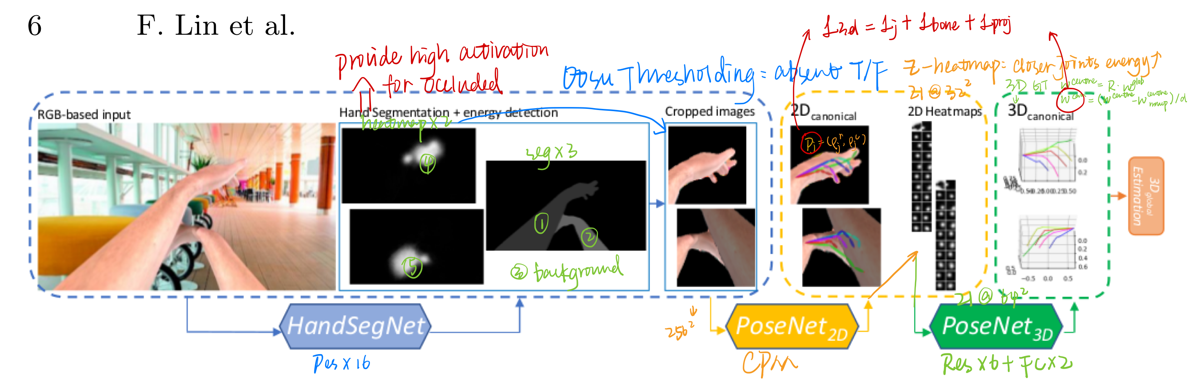
L_{3D} = L_{j} + L_{bone}+ L_{proj}
L_{j} MSE loss for joint regression
L_{bone} MSE between the ground truth and the predicted bone lengths
L_{proj} MSE between the (x, y) component of w^{can} and p projected into the same canonical frame.

Slide 4
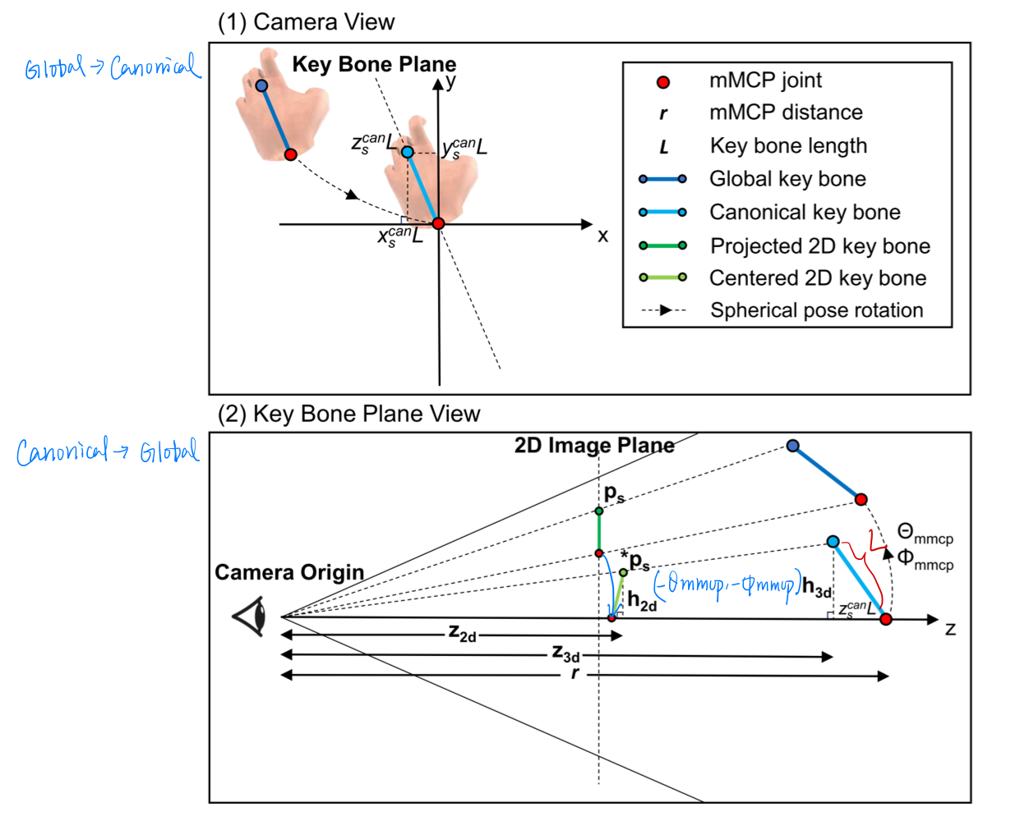
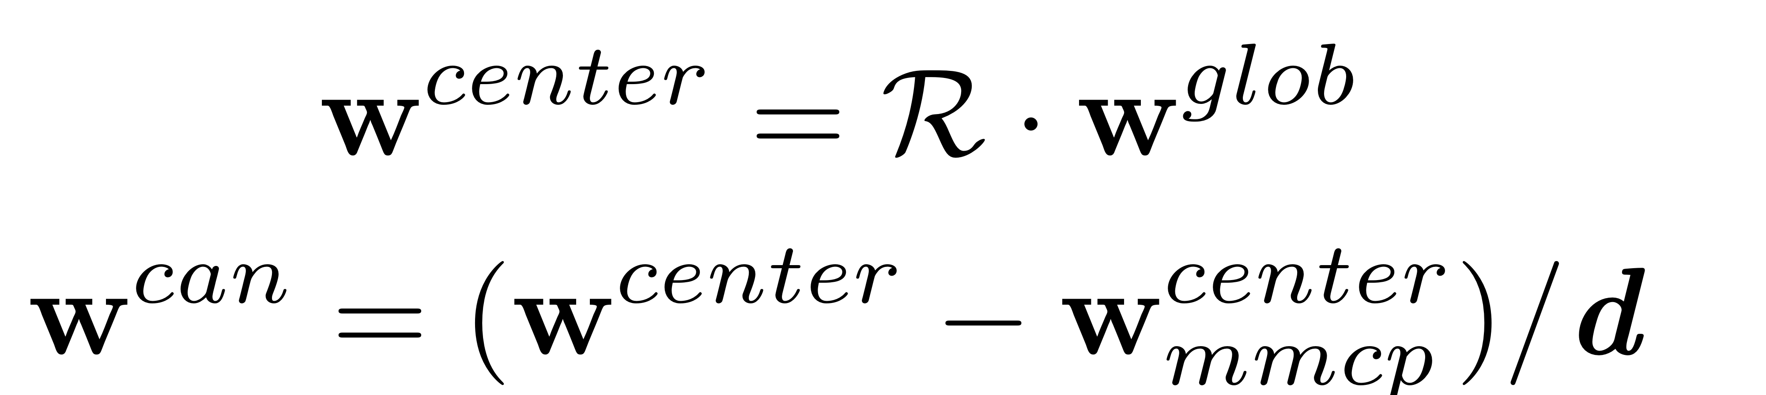
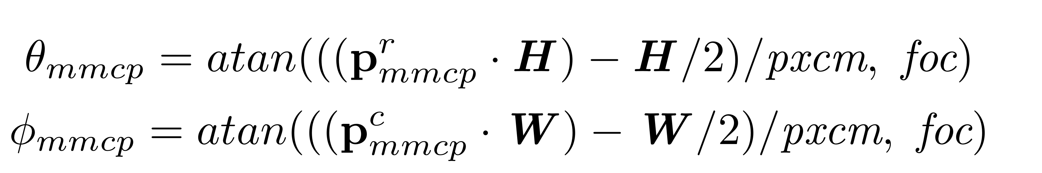

Slide 5
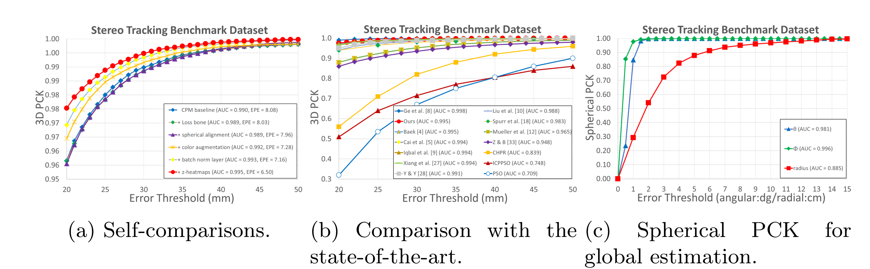
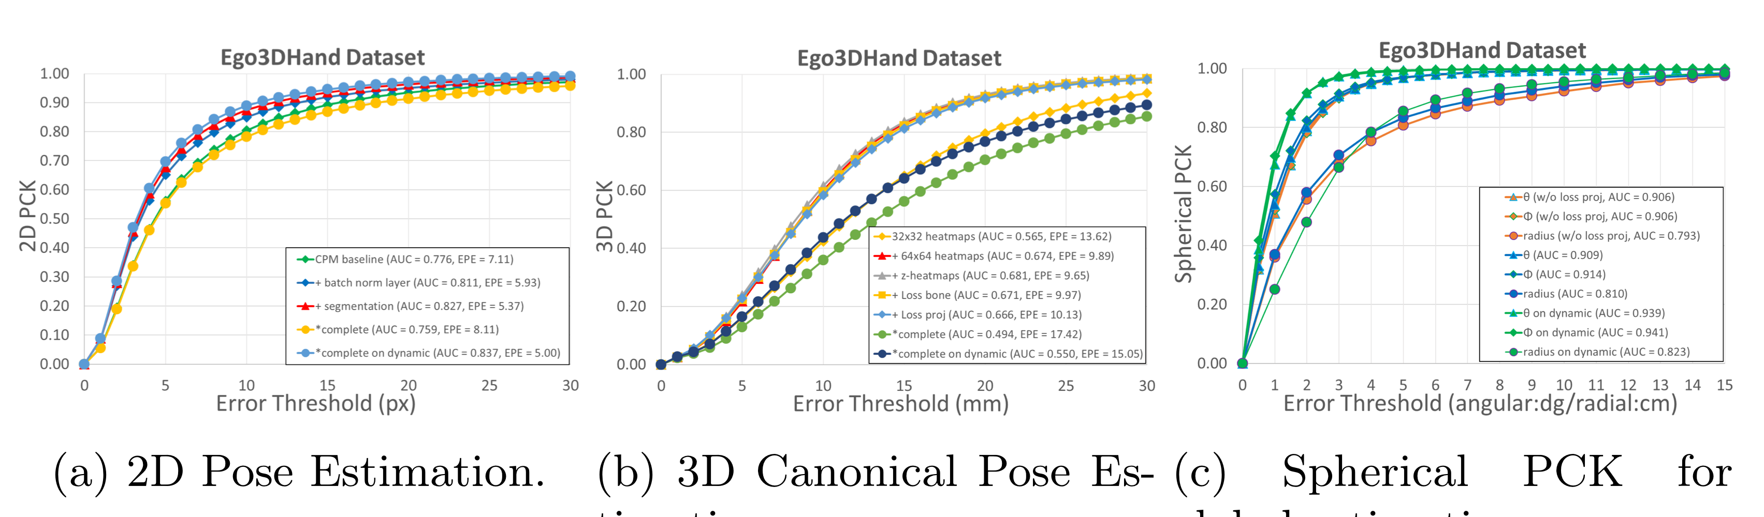

Slide 6
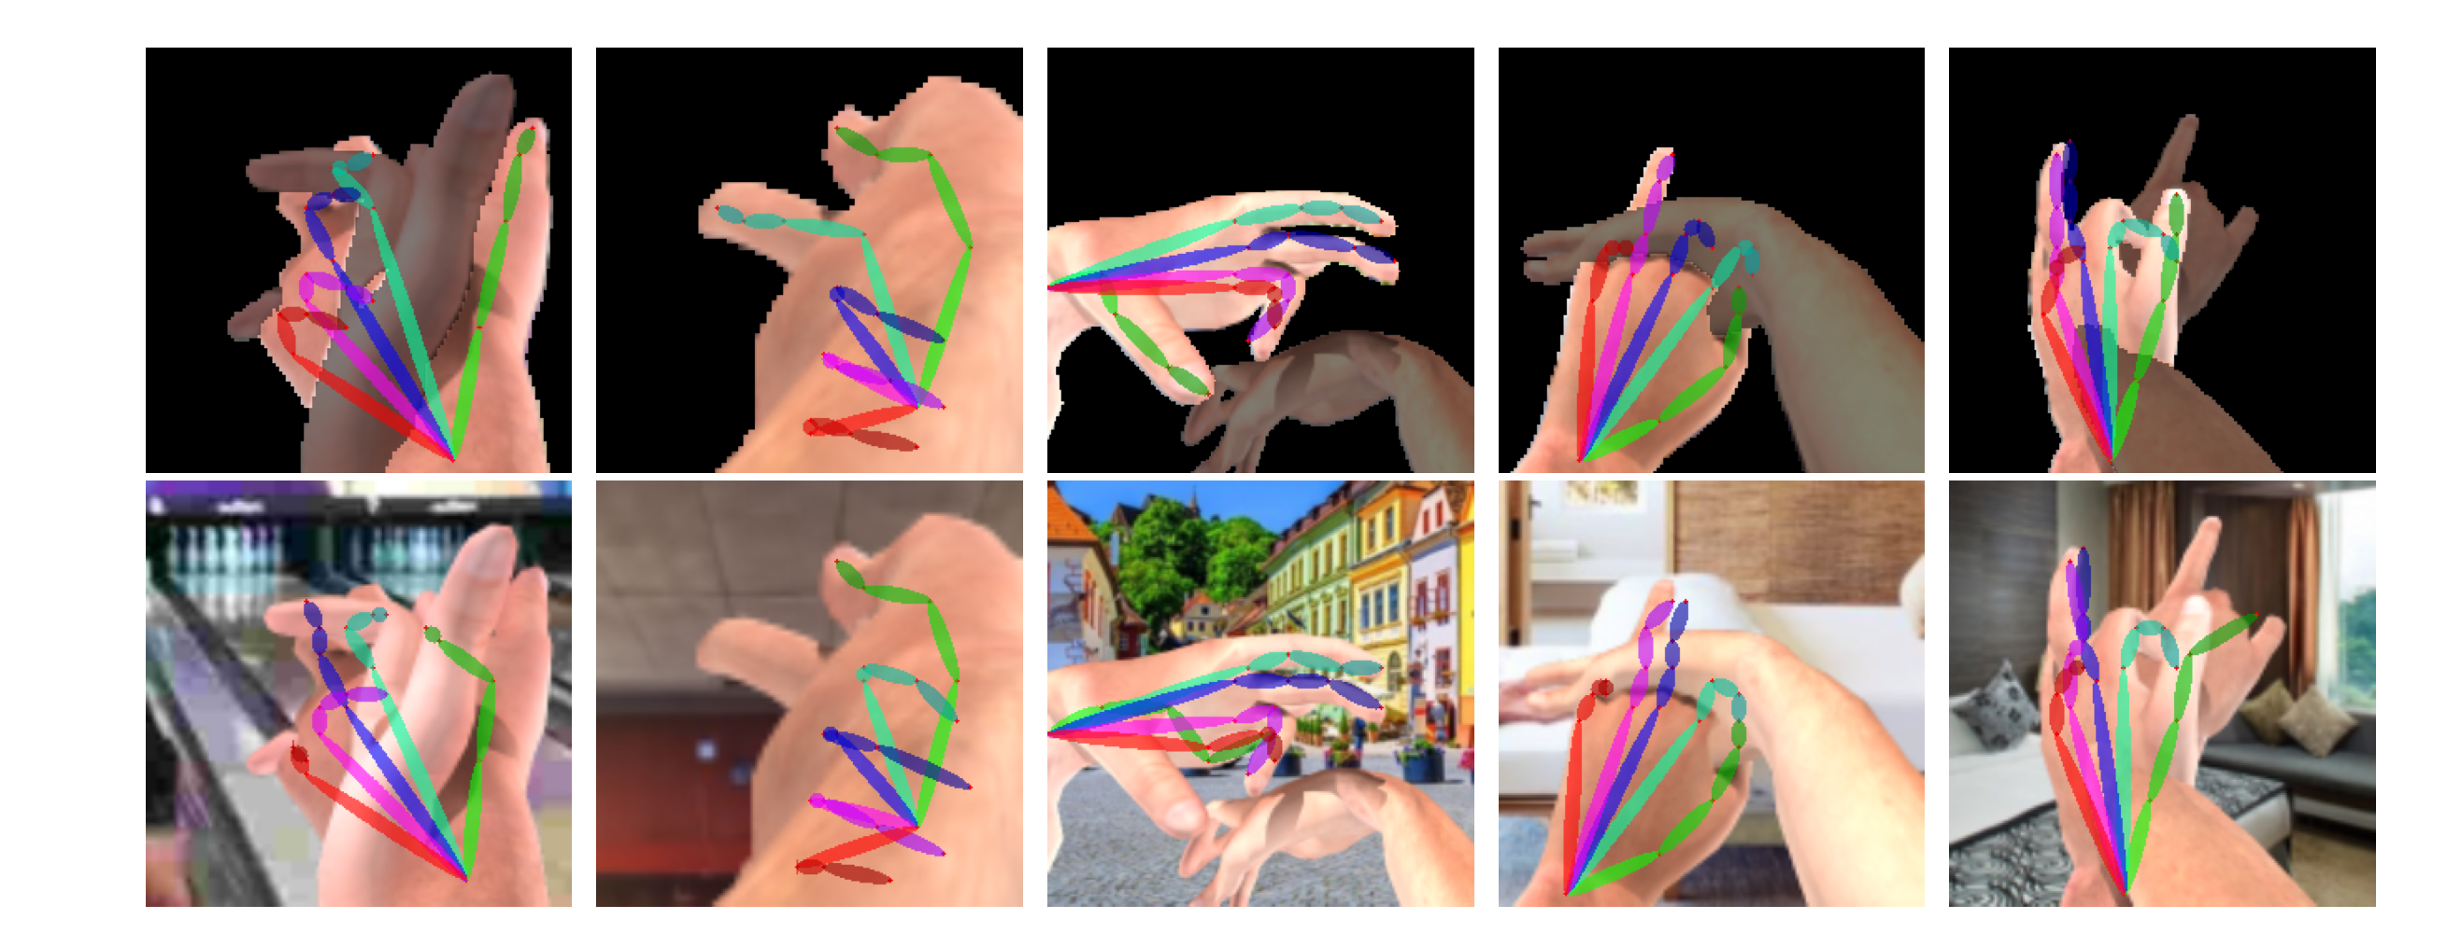

Slide 7
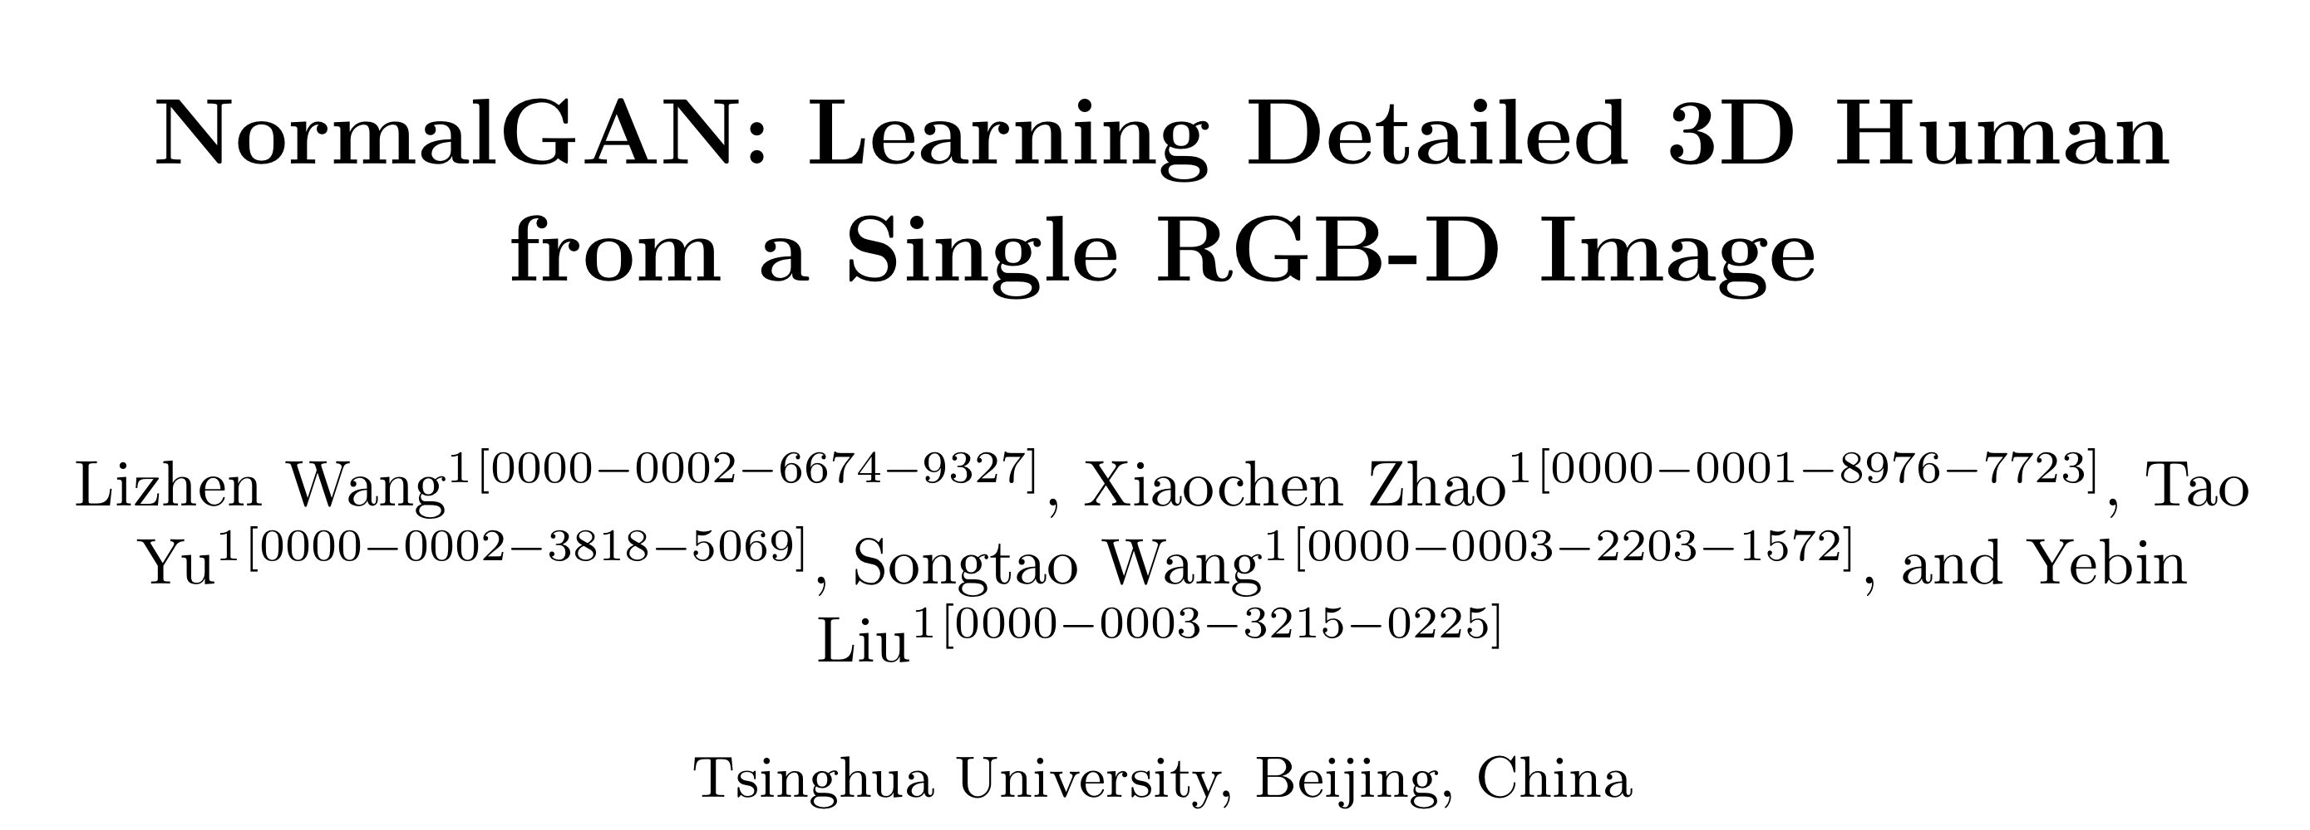

Slide 8
Assumption
Double-sided representation
Front-view: visible
Back-view: invisible
Irregular sampling

Slide 9
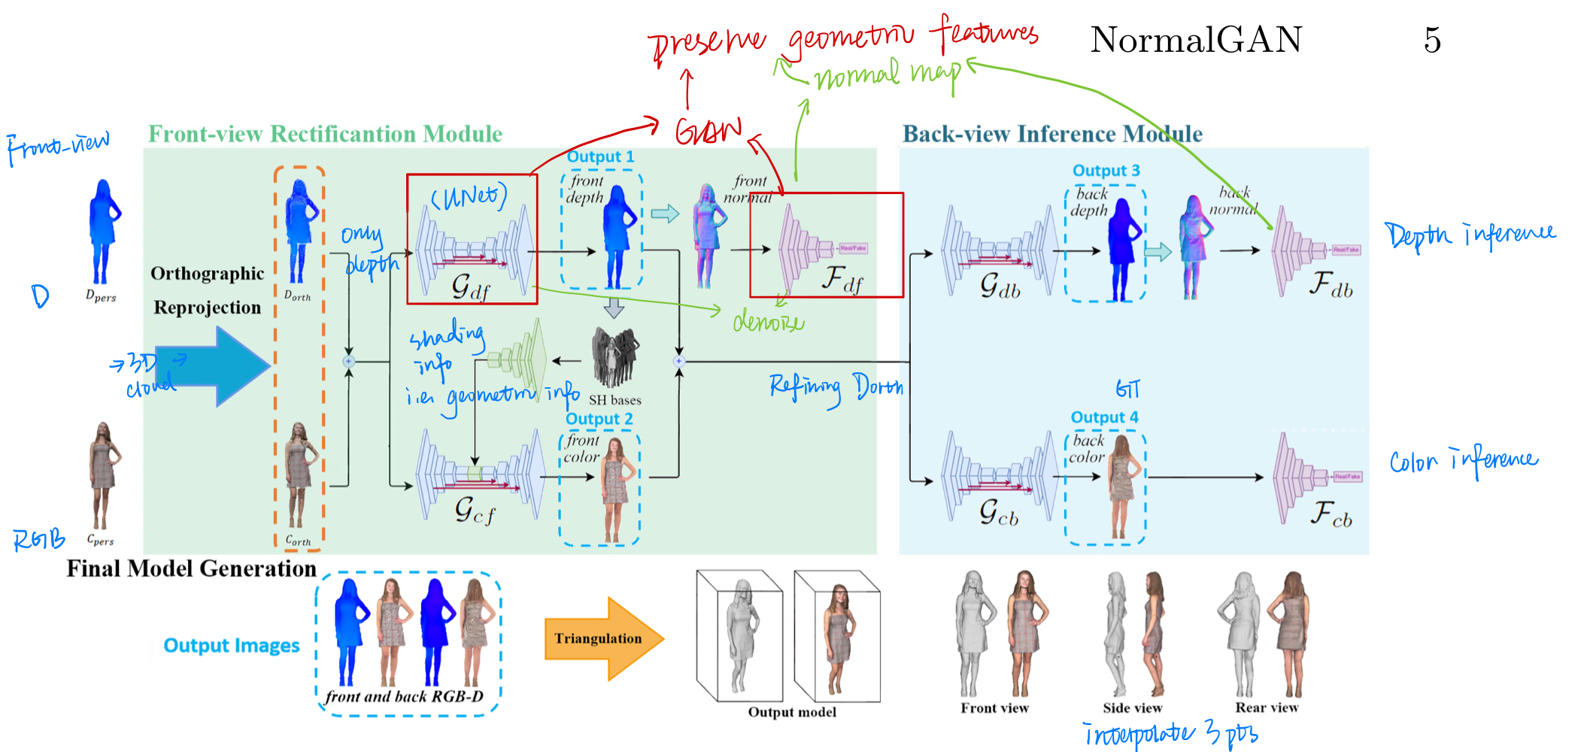
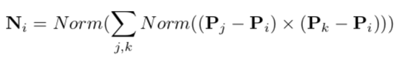
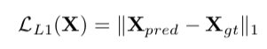
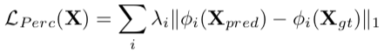
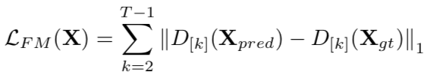
Discriminator

Slide 10
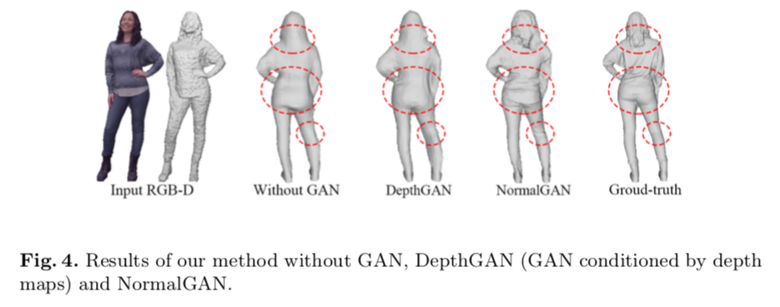
GAN conditioned by normal maps rather than depth map

Slide 11
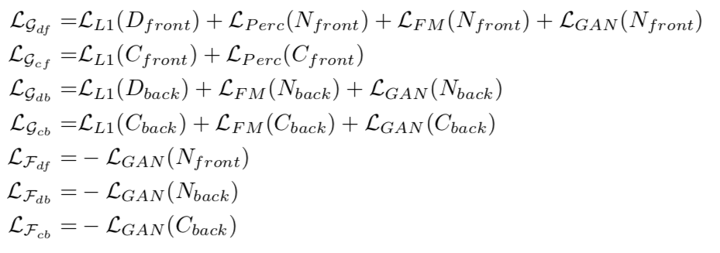
Loss functions

Slide 12
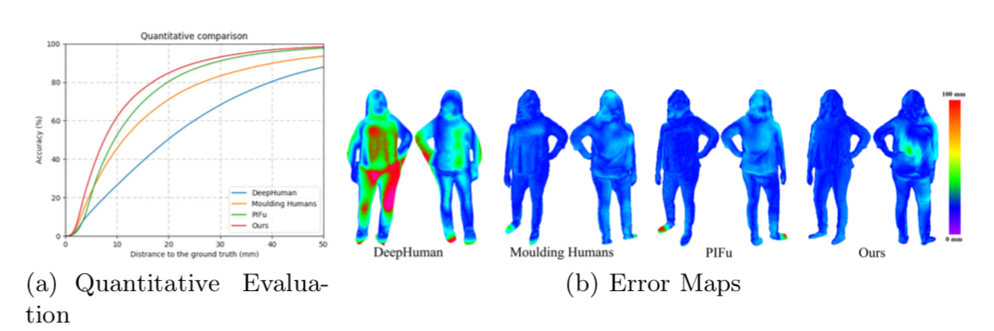
Experiment

